Slide 1
Tile Masters
2IO75 DBL embedded systems
Pitch robot design

Slide 2
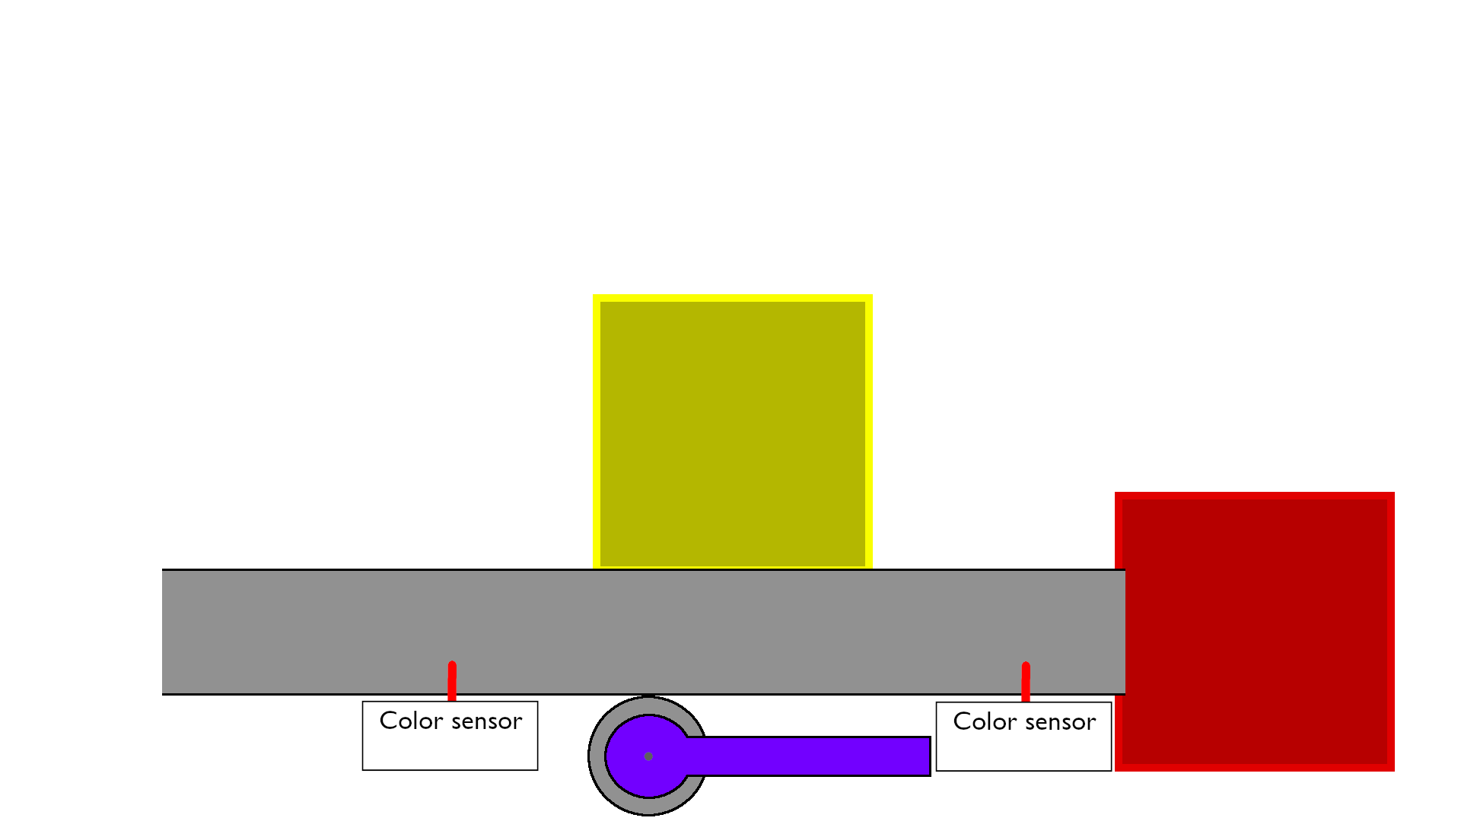

Slide 3
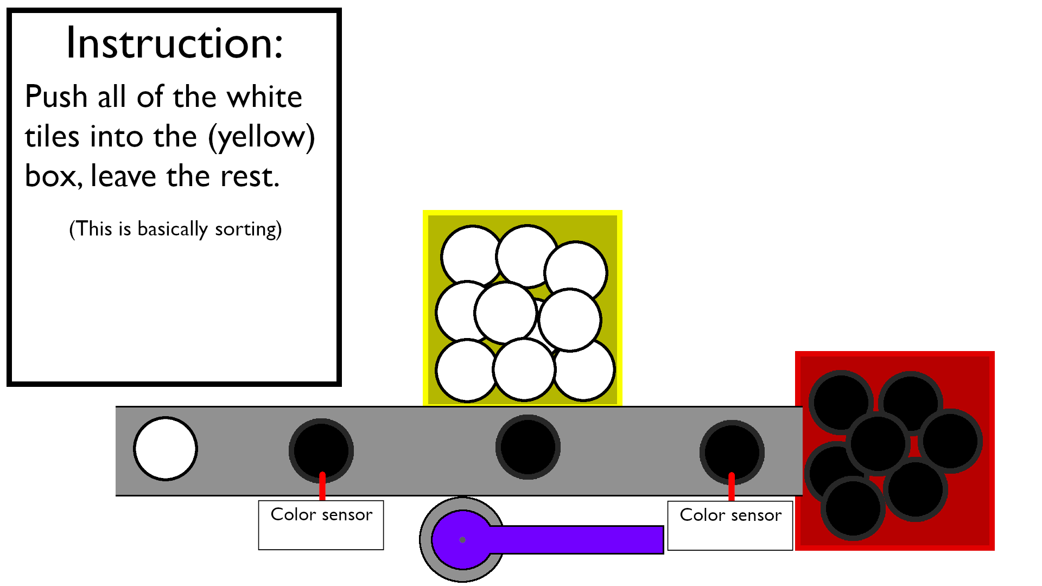

Slide 4
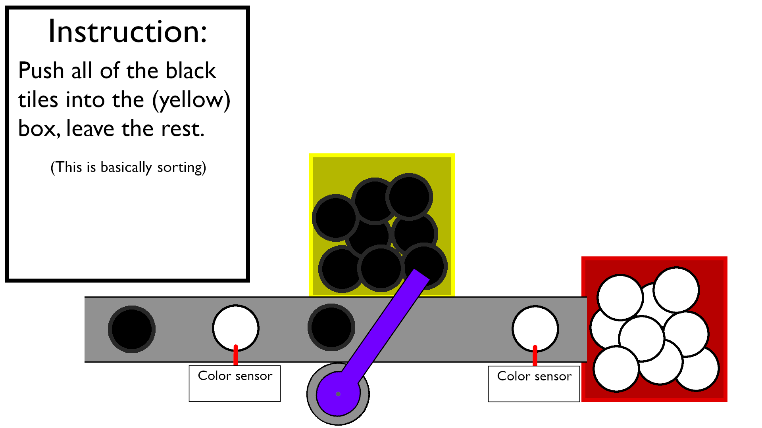

Slide 5
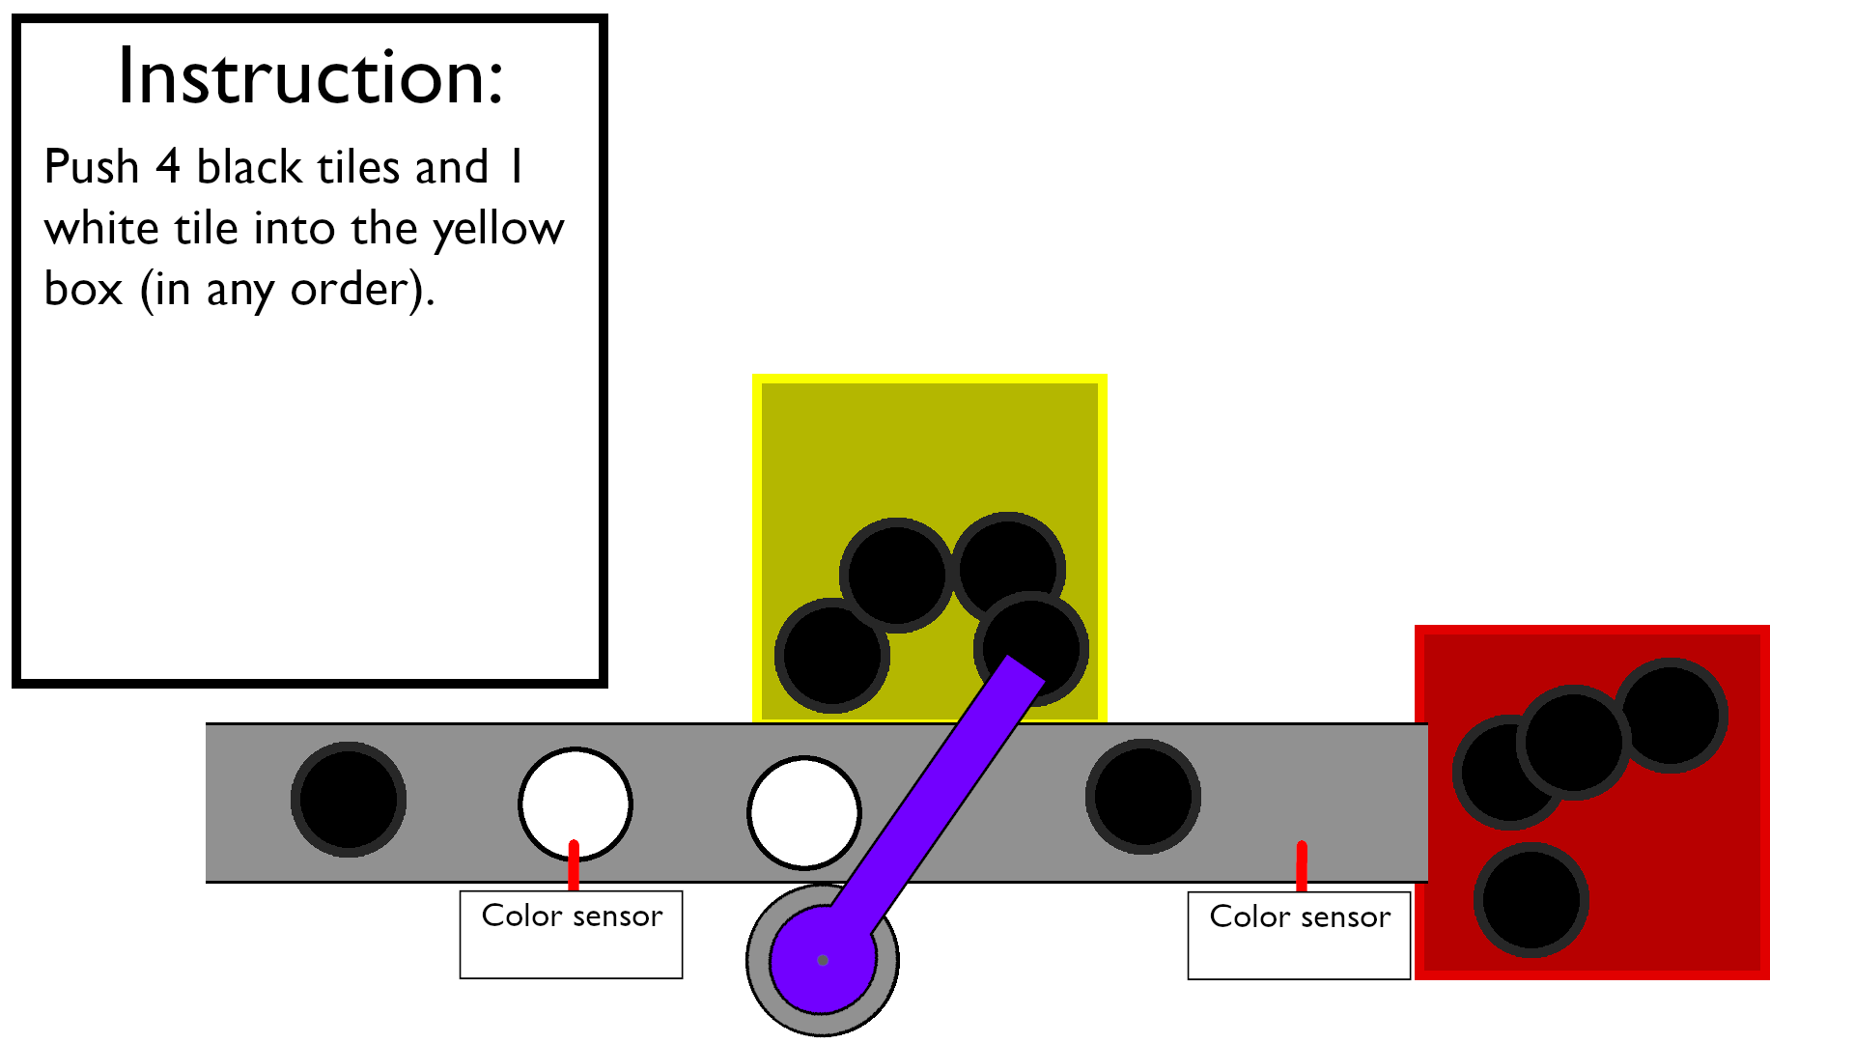

Slide 6
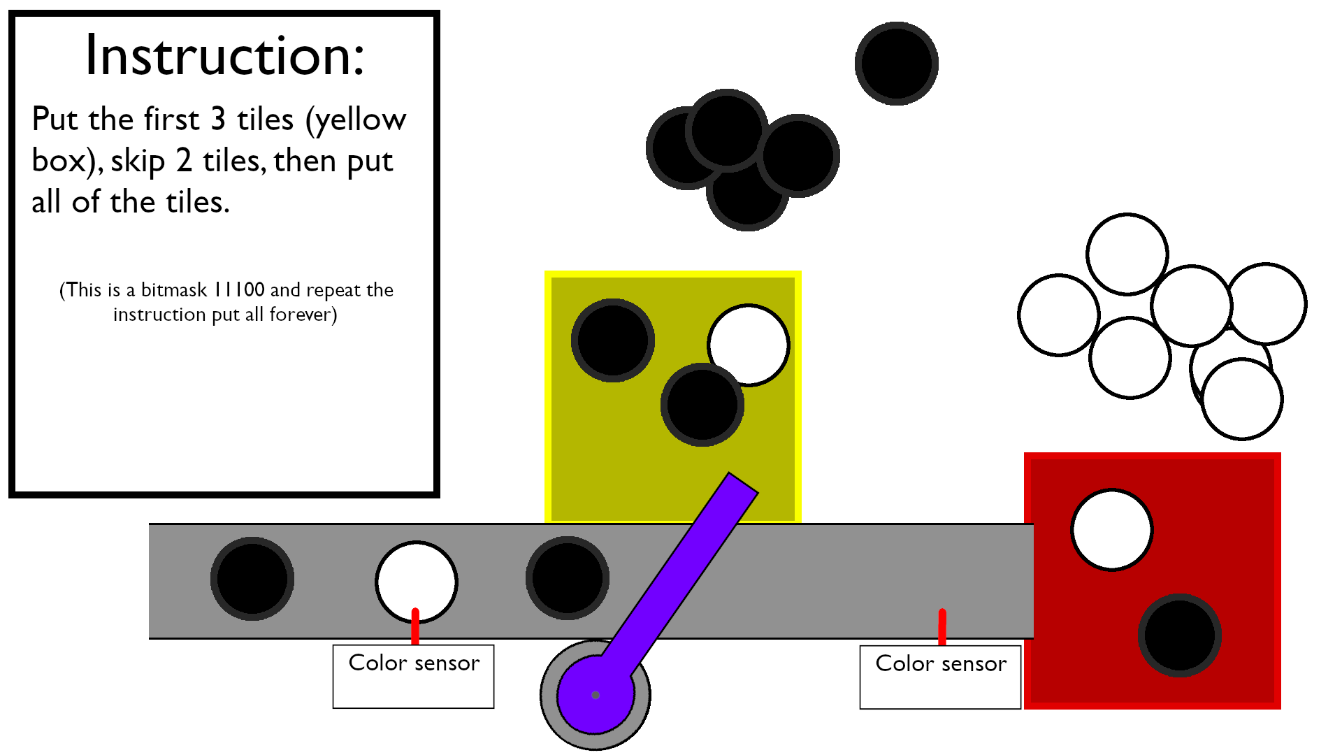

Slide 7
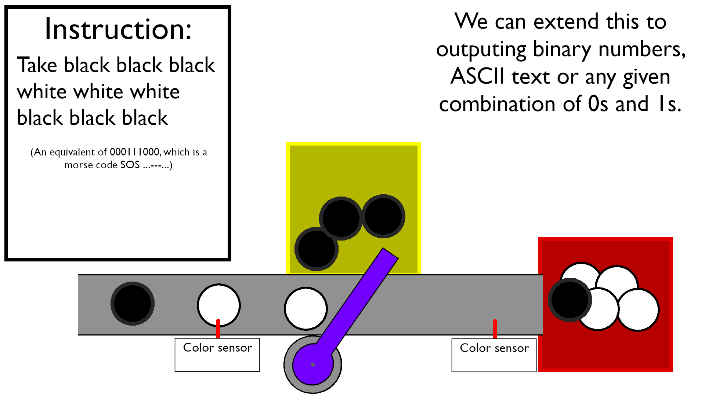

Slide 8
The project is made by:
Maciej Garbacz
Dominika Chabior
Aadersh KalyanaSundaram
Agnes Vulperscu
Chloe Antonozzi
Salahedin Salahedin Mokhtar Diaa Abdelmoneim Nounou

